Slide 1
ART
(Adaptive Resonance Theory)

Slide 2
Contents
Unsupervised ANNs
Kohonen Self-Organising Map (SOM)
Adaptive Resonance Theory (ART)
ART1
  Architeture
  Learning algorithm
  Example
ART2
  Architeture
  Learning algorithm
  Example
ART Applications
Adaptive Resonance Theory NN

Slide 3
Unsupervised ANNs
Usually 2-layer ANN
Only input data are given
ANN must self-organise output
Two main models: Kohonen’s SOM and Grossberg’s ART
Clustering applications
Output layer
Feature layer
Adaptive Resonance Theory NN

Slide 4
Self-Organising Map (SOM)
T. Kohonen (1984)
2D map of output neurons
Input layer and output layer fully connected
Delta rule learning
Output layer
Feature layer
Adaptive Resonance Theory NN

Slide 5
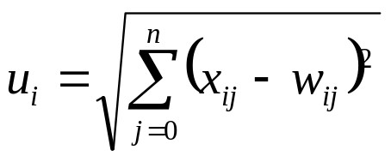
SOM Clustering
Neuron = prototype for a cluster
Weights = reference vector (protoype features)
Euclidean distance between reference vector and input pattern
Competitive layer (winner take all)
Neuron with reference vector closest to input wins
x₁
w_{i1}
x₂
w_{i2}
x₃
w_{i3}
w_{i4}
y_{i}
x₄
w_{i5}
x₅
Neuron i
Adaptive Resonance Theory NN

Slide 6
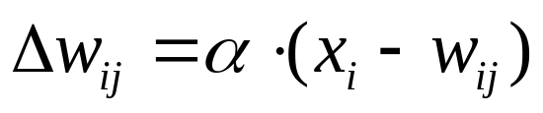
SOM Learning Algorithm
Only weights of winning neuron and its neighbours are updated
Weights of winning neuron brought closer to input pattern
Gradual lowering of learning rate ensures stability (otherwise vectors may oscillate between clusters)
N(t) = Neighbourhood function
E(τ₀)
E(τ₁)
E(τ₂)
E(τ₃)
Adaptive Resonance Theory NN

Slide 7
SOM Applications
Natural language processing
  Document clustering
  Document retrieval
  Automatic query
Image segmentation
Data mining
Fuzzy partitioning
Condition-action association
Adaptive Resonance Theory NN

Slide 8
Adaptive Resonance Theory (ART)
Carpenter and Grossberg (1987)
On-line clustering algorithm
Recurrent ANN
Competitive output layer
Data clustering applications
Stability-plasticity dilemma
Output layer
Feature layer
Adaptive Resonance Theory NN

Slide 9
Stability-Plasticity Dilemma
Stability: system behaviour doesn’t change after irrelevant events
Plasticity: System adapts its behaviour according to significant events
Dilemma: how to achieve stability without rigidity and plasticity without chaos?
  Ongoing learning capability
  Preservation of learned knowledge
Adaptive Resonance Theory NN

Slide 10
ART Architecture
Bottom-up weights b_{ij}
Top-down weights t_{ij}
  Store class template
Input nodes
  Vigilance test
  Input normalisation
Output nodes
  Forward matching
Long-term memory
  ANN weights
Short-term memory
  ANN activation pattern
top down
bottom up (normalised)
Adaptive Resonance Theory NN

Slide 11
ART Algorithm
new pattern
recognition
comparison
categorisation
known
unknown
Incoming pattern matched with stored cluster templates
If close enough to stored template joins best matching cluster, weights adapted
If not, a new cluster is initialised with pattern as template
Adapt winner node
Initialise uncommitted node
Adaptive Resonance Theory NN

Slide 12
ART Types
ART1: Unsupervised Clustering of binary input vectors.
ART2: Unsupervised Clustering of real-valued input vectors.
ART3: Incorporates "chemical transmitters" to control the search process in a hierarchical ART structure.
ARTMAP: Supervised version of ART that can learn arbitrary mappings of binary patterns.
Fuzzy ART: Synthesis of ART and fuzzy logic.
Fuzzy ARTMAP: Supervised fuzzy ART
dART and dARTMAP: Distributed code representations in the F2 layer (extension of winner take all approach).
Gaussian ARTMAP
Adaptive Resonance Theory NN

Slide 13
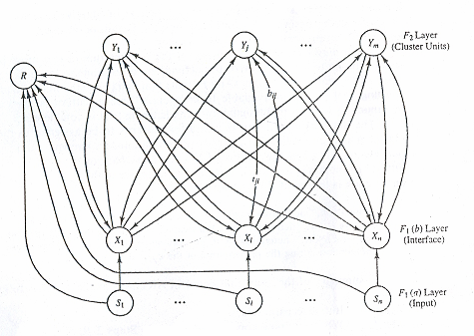
ART1 Architecture
Adaptive Resonance Theory NN

Slide 14
Additional Modules
Categorisation result
Output layer
Gain control
Reset module
Input layer
Input pattern
Adaptive Resonance Theory NN

Slide 15
Reset Module
Fixed connection weights
Implements the vigilance test
Excitatory connection from F1(b)
Inhibitory connection from F1(a)
Output of reset module inhibitory to output layer
Disables firing output node if match with pattern is not close enough
Duration of reset signal lasts until pattern is present
Adaptive Resonance Theory NN

Slide 16
Gain module
Fixed connection weights
Controls activation cycle of input layer
Excitatory connection from input lines
Inhibitory connection from output layer
Output of gain module excitatory to input layer
2/3 rule for input layer
Adaptive Resonance Theory NN

Slide 17
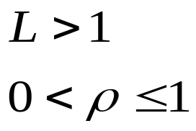
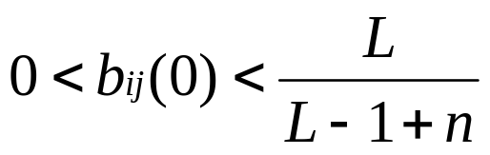
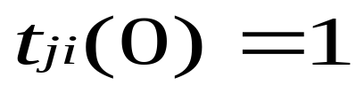
ART1 Algorithm
Step 0 : initialize parameters :
initialize weights :
Adaptive Resonance Theory NN

Slide 18
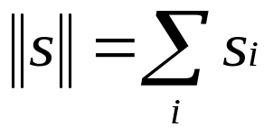

ART1 Algorithm (cont.)
Step 1: While stopping condition is false do Steps 2-13
Step 2: For each training input . do steps 3-12
Step 3: Set activations of all F2 units to zero.
Set activations of F1(a) units to input vector s.
Step 4: Compute the norm of s:
Step 5: Send input signal from F1(a) to the F1(b) layer
Adaptive Resonance Theory NN

Slide 19

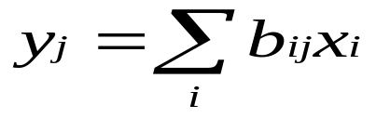
ART1 Algorithm (cont.)
Step 6: For each F2 node that is not inhibited:
if . then
Step 7: While reset is true. do Steps 8-11.
Step 8: find J such that y_{J}≥y_{j} for all nodes j.
If y_{J} then all nodes are inhibited and this pattern cannot be clustered.
Step 9: Recompute activation x of F1(b)
x_{i} = s_{i}t_{Ji}
Adaptive Resonance Theory NN

Slide 20


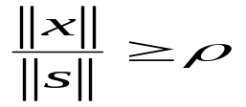
ART1 Algorithm (cont.)
Step 10: Compute the norm of vector x:
Step 11: Test for reset:
if then
y_{J}=-1 (inhibit node J)(and continue executing step 7 again)
If then proceed to step 12.
Adaptive Resonance Theory NN

Slide 21
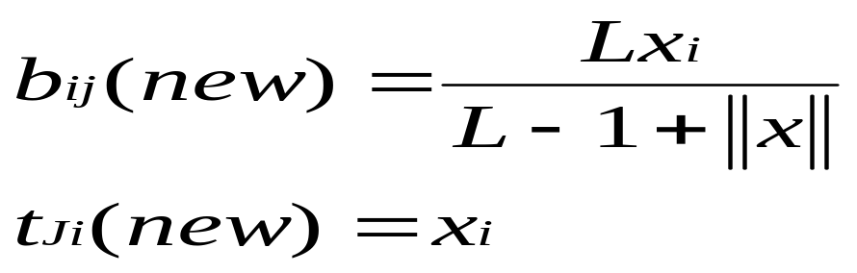
ART1 Algorithm (cont.)
Step 12: Update the weight for node J (fast learning)
Step 13: Test for stopping condition.
Adaptive Resonance Theory NN

Slide 22
Recognition Phase
Forward transmission via bottom-up weights
Input pattern matched with bottom-up weights (normalised template) of output nodes
Inner product x•b_{i}
Best matching node fires (winner-take-all layer)
Similar to Kohonen’s SOM algorithm, pattern associated to closest matching template
ART1: fraction of bits of template also in input pattern
Adaptive Resonance Theory NN

Slide 23
Comparison Phase
Backward transmission via top-down weights
Vigilance test: class template matched with input pattern
If pattern close enough to template, categorisation was successful and “resonance” achieved
If not close enough reset winner neuron and try next best matching
Repeat until
  vigilance test passed
  Or (all committed neurons) exhausted
Adaptive Resonance Theory NN

Slide 24
Vigilance Threshold
Vigilance threshold sets granularity of clustering
It defines amount of attraction of each prototype
Low threshold
  Large mismatch accepted
  Few large clusters
  Misclassifications more likely
High threshold
  Small mismatch accepted
  Many small clusters
  Higher precision
Small ρ, imprecise
Large ρ, fragmented
Adaptive Resonance Theory NN

Slide 25
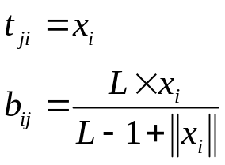
Adaptation
Only weights of winner node are updated
Only features common to all members of cluster are kept
Prototype is intersection set of members
ART1
Adaptive Resonance Theory NN

Slide 26
Issues about ART1
Learned knowledge can be retrieved
Fast learning algorithm
Difficult to tune vigilance threshold
New noisy patterns tend to “erode” templates
ART1 is sensitive to order of presentation of data
Accuracy sometimes not optimal
Only winner neuron is updated, more “point-to-point” mapping than SOM
Adaptive Resonance Theory NN

Slide 27
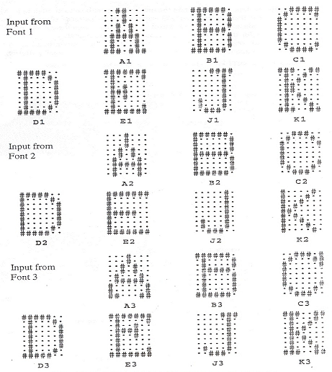
ART1 Example : character recognition
Adaptive Resonance Theory NN

Slide 28
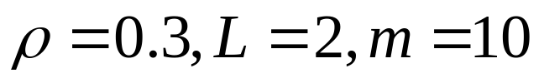
ART1 Example : character recognition
Initial values of parameters :
Order of presentation : A1,A2,A3,B1,B2…
Cluster patterns
1 A1,A2
2 A3
3 C1,C2,C3,D2
4 B1,D1,E1,K1
B3,D3,E3,K3
5 K2
6 J1,J2,J3
7 B2,E2
Adaptive Resonance Theory NN

Slide 29
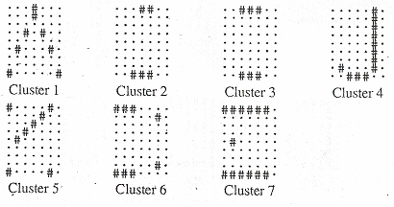
ART1 Example : character recognition
Adaptive Resonance Theory NN

Slide 30
ART2
Unsupervised Clustering for :
  Real-valued input vectors
  Binary input vectors that are noisy
  Includes a combination of normalization and noise suppression
Adaptive Resonance Theory NN

Slide 31
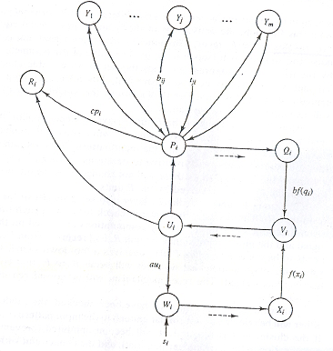
ART2 Architecture
Adaptive Resonance Theory NN

Slide 32
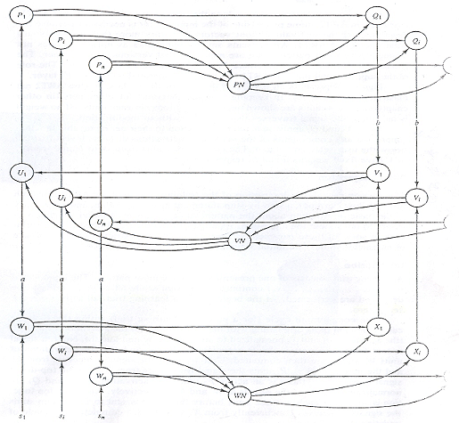
ART2 Architecture (normalization)
Adaptive Resonance Theory NN

Slide 33
ART2 Learning Mode
Fast Learning
  Weights reach equilibrium in each learning trial
  Have some of the same characteristics as the weight found by ART1
  More appropriate for data in which the primary information is contained in the pattern of components that are ‘small’ or ‘large’
Slow Learning
  Only one weight update iteration performed on each learning trial
  Needs more epochs than fast learning
  More appropriate for data in which the relative size of the nonzero components is important
Adaptive Resonance Theory NN

Slide 34
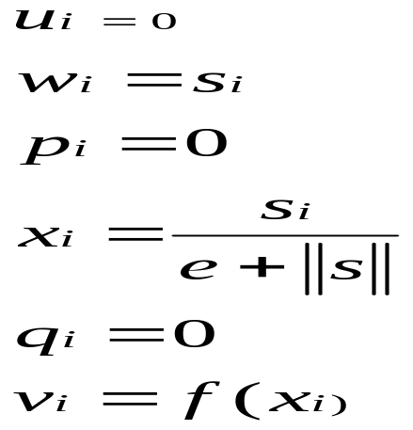
ART2 Algorithm
Step 0: Initialize parameters:
a, b, ө, c, d, e, α, ρ.
Step 1: Do Steps 2-12 N-EP times.
(Perform the specified number of epochs of training.)
Step 2: For each input vector s, do steps 3-11.
Step 3: Update F1 unit activations:
Adaptive Resonance Theory NN

Slide 35
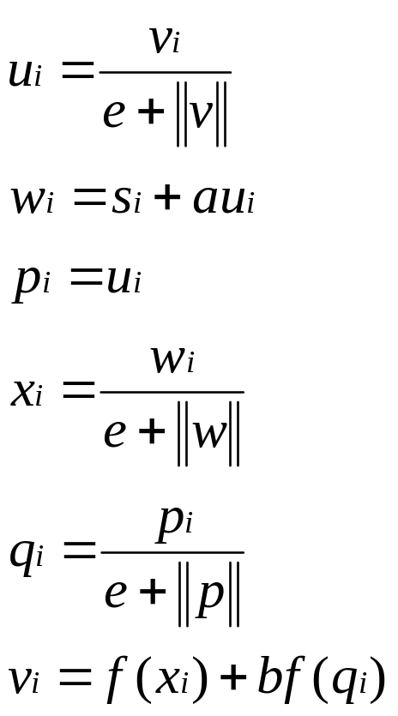
ART2 Algorithm
Update F1 unit activations again:
Adaptive Resonance Theory NN

Slide 36
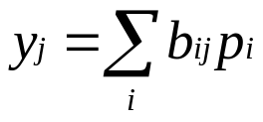
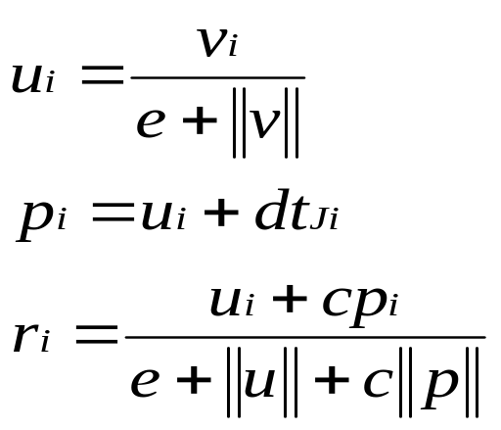
ART2 Algorithm
Step 4: Compute signals to F2 units:
Step 5: While reset is true, do Steps 6-7.
Step 6: Find F2 unit Y_{J} with largest signal .(Define J such that y_{J}≥y_{j} for j=1…m.)
Step 7: Check for reset:
Adaptive Resonance Theory NN

Slide 37


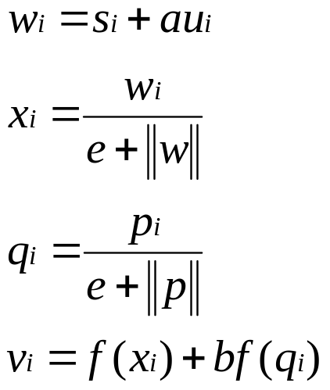
ART2 Algorithm
If then
y_{J}=-1 (inhibit J)
(reset is true; repeat Step 5);
If then
Reset is false; proceed to Step 8.
Adaptive Resonance Theory NN

Slide 38
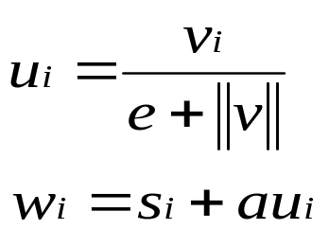
ART2 Algorithm
Step 8: Do Steps 9-11 N_IT times.
(Performs the specified number of learning iterations.)
Step 9. Update weights for winning unit J:
t_{Ji} = αdui+{1+αd(d-1)}t_{Ji}
b_{iJ}= αdui+{1+αd(d-1)}b_{Ji}
Step 10: Update F1 activations:
Adaptive Resonance Theory NN

Slide 39
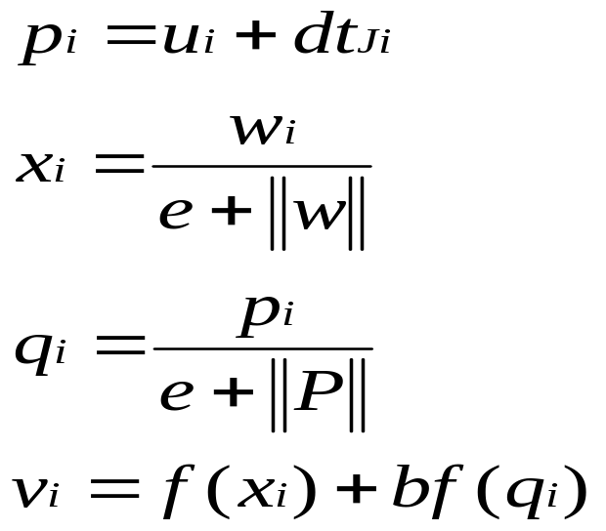
ART2 Algorithm
Step11: Test stopping condition for weight updates.
Step 12: Test stopping condition for number of epochs.
Adaptive Resonance Theory NN

Slide 40
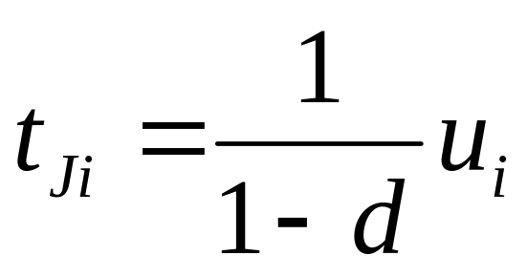
Final Cluster Weight Vector
In fast learning :
In slow learning :
  After adequate epochs , top-down weights converge to average of learned patterns by that cluster
Adaptive Resonance Theory NN

Slide 41
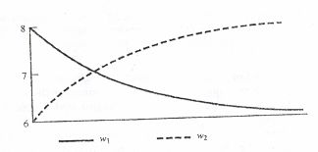
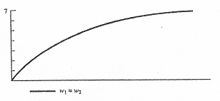
Result for each learning mode
Fast Learning
Slow Learning
Adaptive Resonance Theory NN

Slide 42
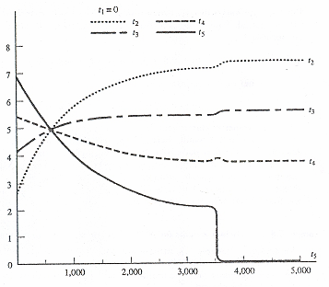
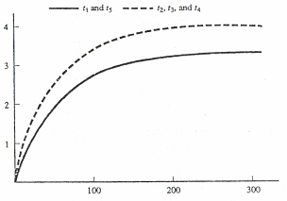
Result for each learning mode
Fast Learning
Slow Learning
Adaptive Resonance Theory NN

Slide 43
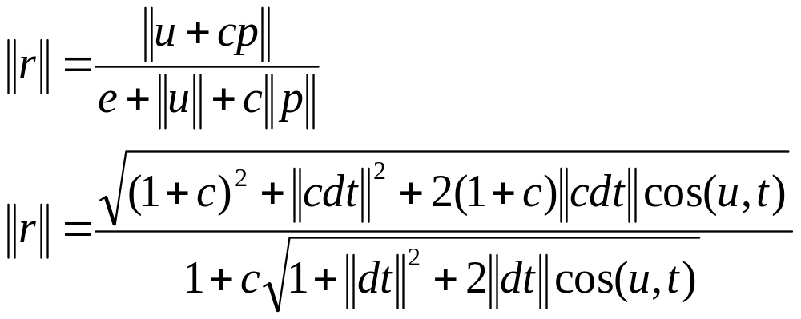
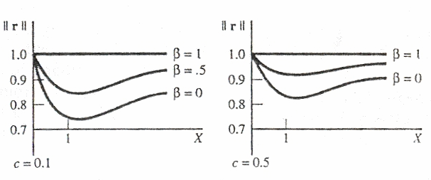
ART2 Reset Mechanism
Adaptive Resonance Theory NN

Slide 44
ART2 Example : character recognition
Adaptive Resonance Theory NN

Slide 45
ART2 Example : character recognition
Initial values of parameters :
Order of presentation : A1,A2,A3,B1,B2…
Cluster patterns
1 A1,A2
2 A3
3 C1,C2,C3,D2
4 B1,D1,E1,K1
B3,D3,E3,K3
5 K2
6 J1,J2,J3
7 B2,E2
Adaptive Resonance Theory NN

Slide 46
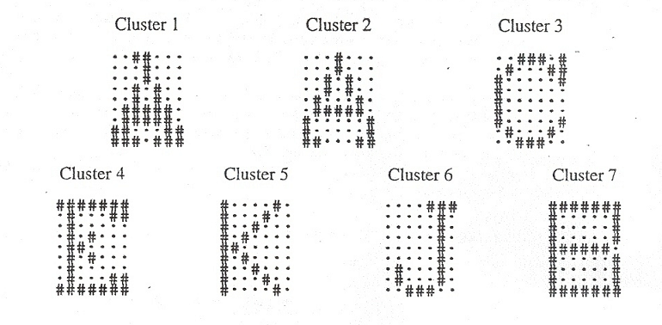
ART2 Example : character recognition
Adaptive Resonance Theory NN

Slide 47
ART2 Example : character recognition
Initial values of parameters :
Order of presentation : A1,B1,C1,…,A2,B2,C2…
Cluster patterns
1 A1,A2
2 B1,D1,E1,K1
B3,D3,E3,K3
3 C1,C2,C3
4 J1,J2,J3
5 B2,D2,E2
6 K2
7 A3
Adaptive Resonance Theory NN

Slide 48
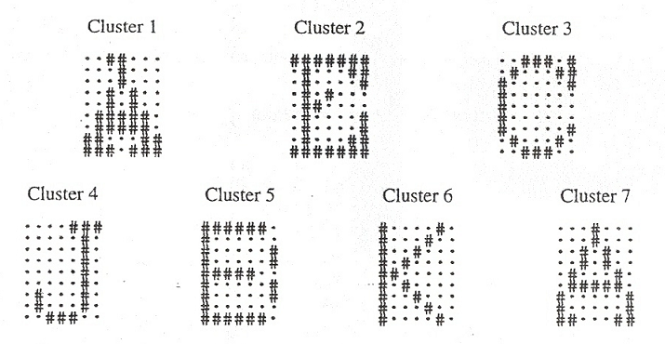
ART2 Example : character recognition
Adaptive Resonance Theory NN

Slide 49
ART Applications
Natural language processing
  Document clustering
  Document retrieval
  Automatic query
Image segmentation
Character recognition
Data mining
  Data set partitioning
  Detection of emerging clusters
Fuzzy partitioning
Condition-action association
Adaptive Resonance Theory NN

